Slide 1
Slut Shaming
Jeff Warren, Valeria Delgado, Xochitl Islas, & Emilie Lacy
Notes:
Xochitl

Slide 2
Kahoot!
Go to Kahoot.it to sign in
Link: https://play.kahoot.it/#/k/89e3c620-45cf-42b5-bbcd-bb14db7c5c2f
Notes:
Xochitl

Slide 3
What Our Kiddos will Define Sult-Shaming as
“An unfortunate phenomenon in which people degrade or mock a woman because she enjoys having sex, has sex a lot, or may even just be rumored to participate in sexual activity...
However, since most people would rather women be MORE sexually active than less, slut shaming is counterproductive to the aims of most men and quite a few ladies.”- Urban Dictionary
Guy 1: Ha ha Megan had sex with two guys, she's such a SLUT!
Guy 2: You idiot, do you want her to stop having sex? We should be encouraging this. Your slut shaming will simply discourage more women from sleeping with us and we will be virgins forever.”
Notes:
Emilie

Slide 4
“This is the essence of the sexual double standard: Boys will be boys, and girls will be sluts.”- Huffington Post
Requesting Birth Control
Engaging in sexual activity
Victim blaming for rape and sexual assault
Dress code violations
Notes:
Emilie
Slut-shaming is the experience of being labeled a sexually out-of-control girl or woman (a “slut” or “ho”) and then being punished socially for possessing this identity. Slut-shaming is sexist because only girls and women are called to task for their sexuality, whether real or imagined; boys and men are congratulated for the exact same behavior.

Slide 5
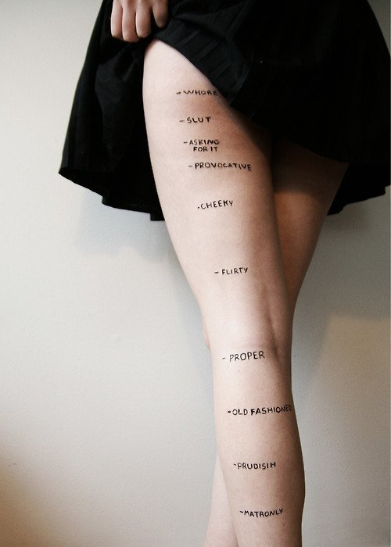
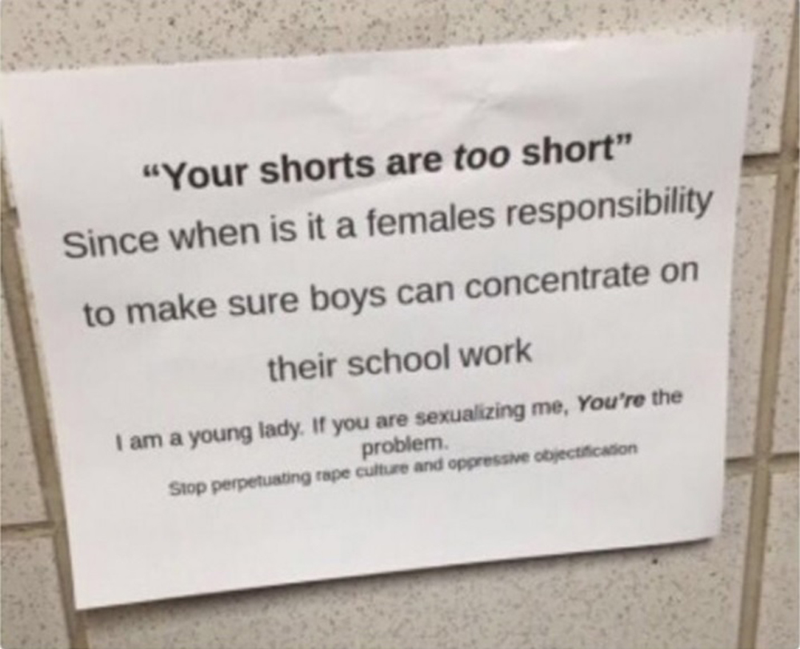
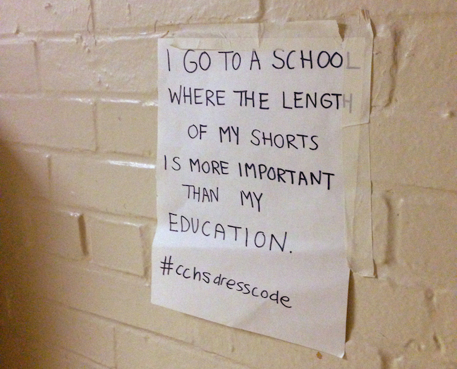
Dress Code =
Sexual Harassment???
“Too distracting for boys.”
Girls feel guilty
Demeaning to boys
Sexualizes children
Girls conforming to a standard
Notes:
Val

Slide 6
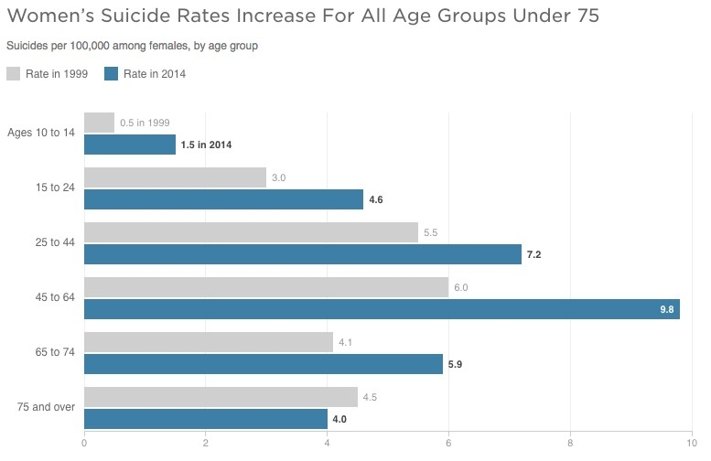
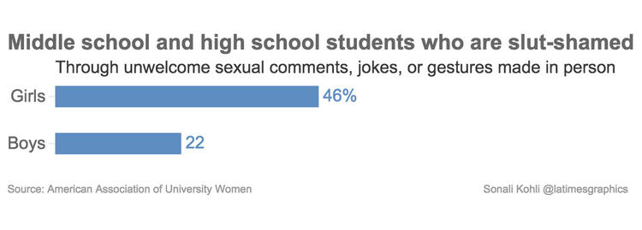
A Glance at the Numbers
“In AAUW’s previous research, more than 80 percent of students reported that they had experienced sexual harassment at least once in their school career.”
Notes:
Val

Slide 7
Consequences
Notes:
Emilie

Slide 8
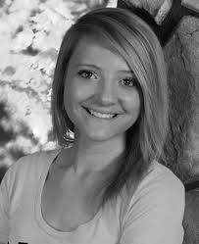
Rachel Flannery
“A note that her parents found after her death read, “I’m fine = I wish I could tell you how I really feel,” alongside a picture of a broken heart”
Notes:
Emilie13 year old Hadn’t been kissed, sult written on her locker, mass text sent to classmates “It was pretty explicit. Something to the effect of that Rachel was a slut and to get her to leave the Kasson-Mantorville School, forward this to everyone you know,” parent Chris Flannery told the station.

Slide 9
Meet Amanda Todd
Notes:
Emilie

Slide 10
Audrie Pott
From Instagram to Snapchat to texting, young people with raging hormones and low impulse control are passing around what amounts to child pornography.
Notes:
Emilie
http://www.rollingstone.com/culture/news/sexting-shame-and-suicide-20130917

Slide 11
Does it ever stop?
Notes:
Jeff

Slide 12
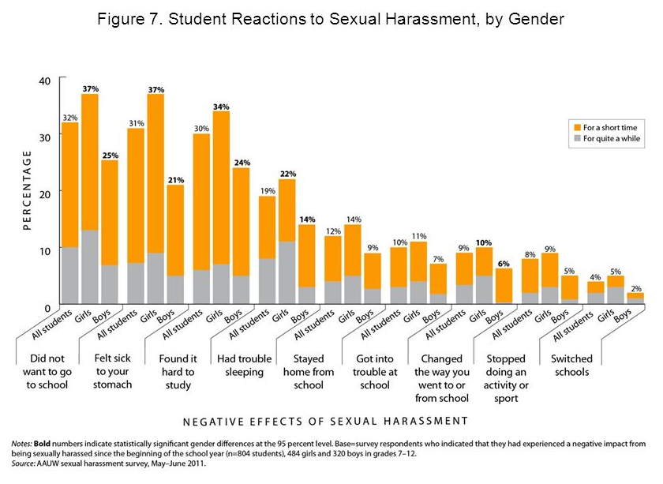
Impact on Learning
https://www.youtube.com/watch?v=G3P922BaTwk
One-third (32 percent) of harassed students
said they did not want to go to school as a
result of the sexual harassment, including 37
percent of girls and 25 percent of boys.
Thirty percent of students said sexual
harassment caused them to have a hard time
studying (34 percent of girls and 24 percent of
boys).
Notes:
Xochitl
Val

Slide 13
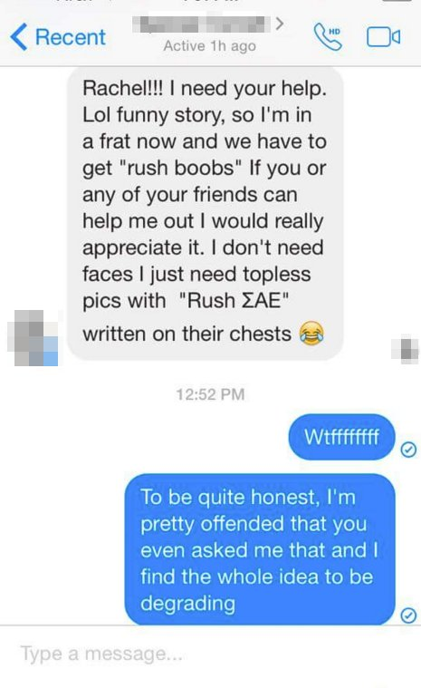
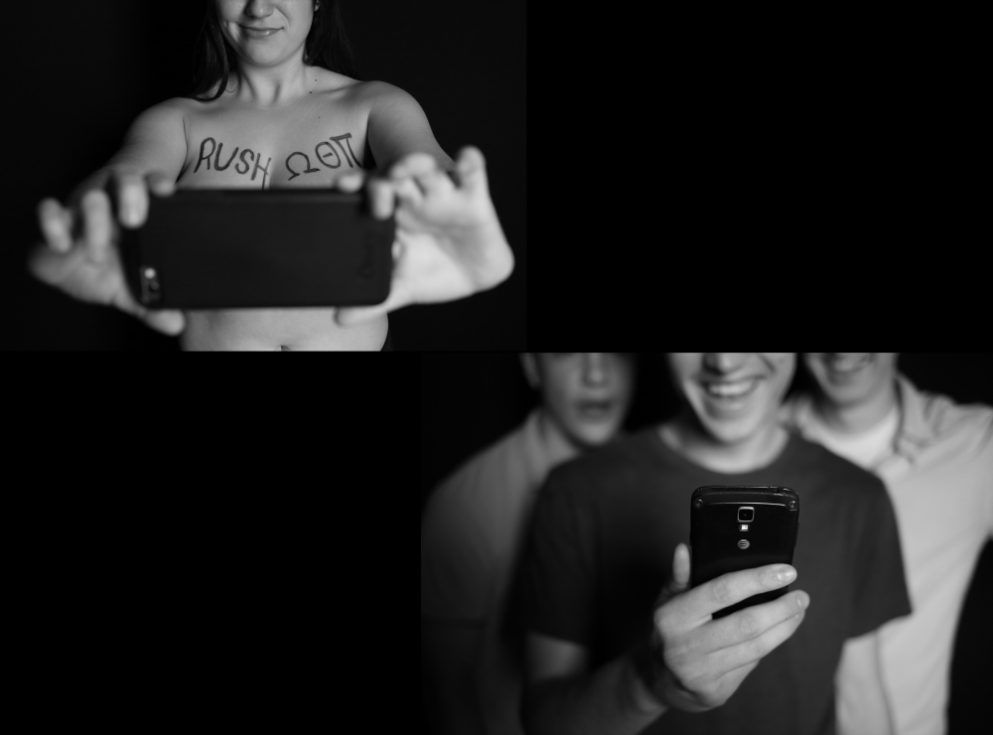
Higher Education - Greek Life
Fraternity Culture
Rush Boobs
Secret Group/Facebook Chats
Sorority Culture
Hazing
Competition Based on What?
Notes:
Jeff

Slide 14
What Can We do?
Notes:
Jeff

Slide 15
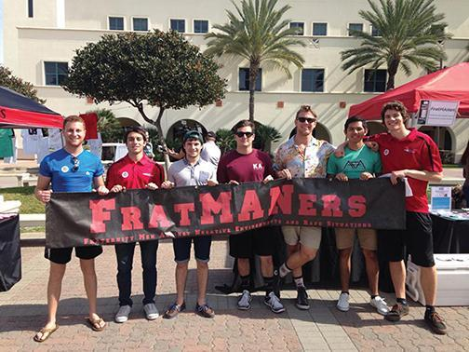
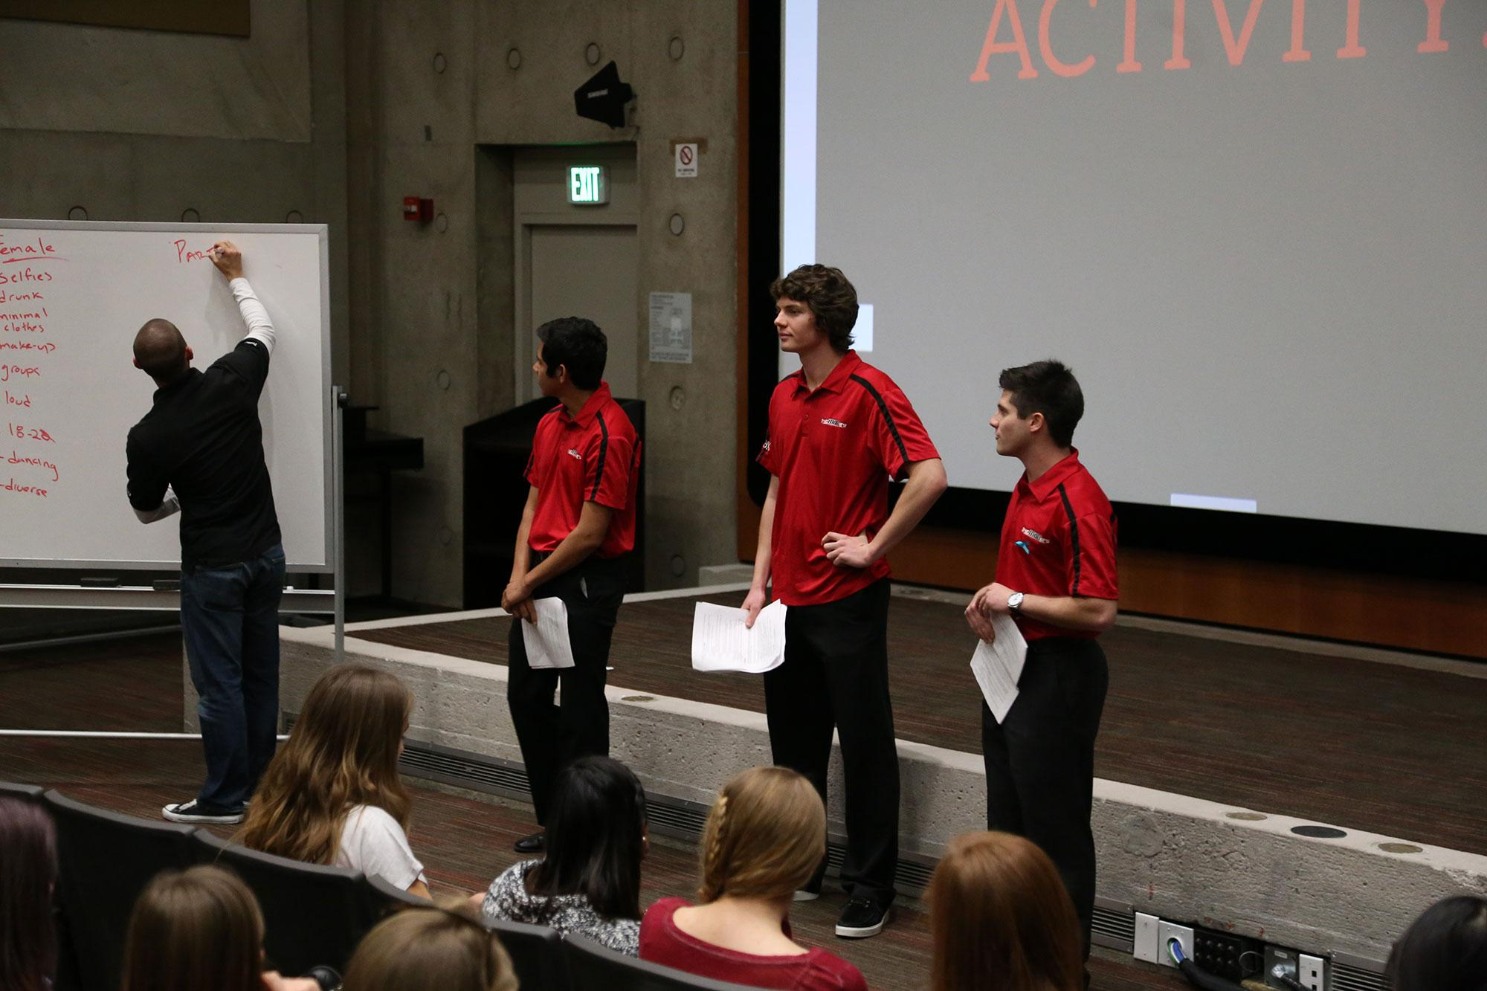
FRAT Manners - San Diego State University
Notes:
Jeff

Slide 16
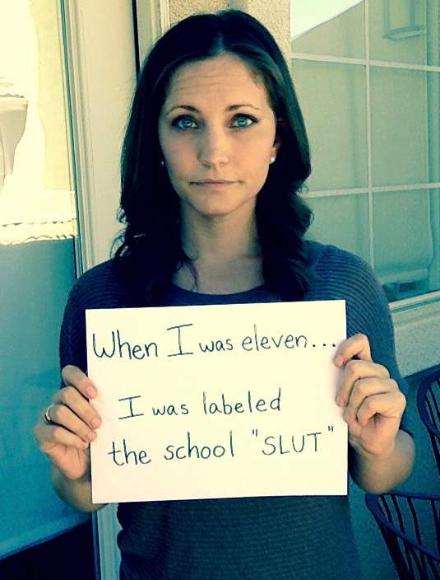
The Unslut Project
Emily Lindin
-Promotes gender equality
-sex positivity
-sexual bullying
https://www.youtube.com/watch?v=LzYVnbIZbR4
http://www.unslutproject.com/
Notes:
Xochitl 2;24

Slide 17
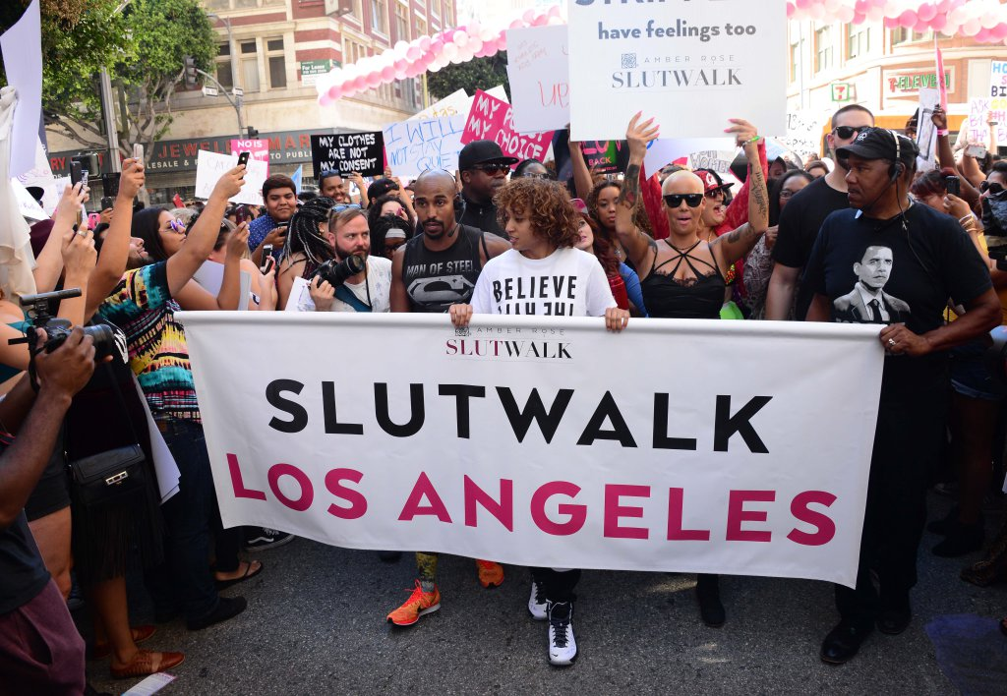
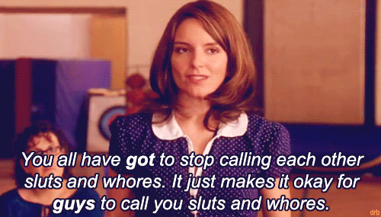
The Amber Rose Foundation
Promotes discussion about women’s right and equality
Fight against victim claiming
Los Angeles Family Therapy
Attending therapy for slut shaming, body shaming , derogatory labeling.
Notes:
Xochitl

Slide 18
National Suicide Prevention Hotline
-Provides free and confidential emotional support.
-24 hours a day, 7 days a week
-Know the risk factors: *hopelessness, history of trauma or abuse, major physical illness, mood disorders, personality disorders
-We can all help
Notes:
Xochitl

Slide 19
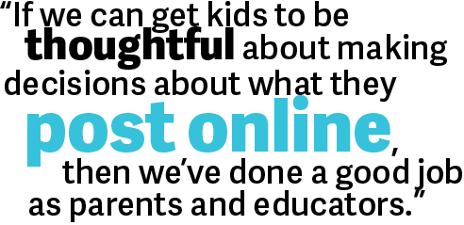
LESSON IDEA - High School ELA
Argumentative Writing Practice:
Instructor will present a high school administration meeting... where Student 1 is said to be cyberbullying Student 2 based on Student 2’s rumored sexual promiscuity. Students will identify, analyze, discuss, and evaluate the complex situation in its entirety, and then write an argumentative paragraph from the viewpoint of a school adminstrator at what the proper course of action should be.
Standard 8.1.G: Encourage and support safe, respectful, and responsible relationships.
Notes:
Jeff

Slide 20
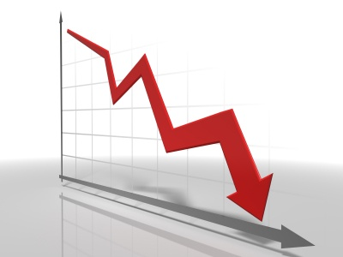
LESSON IDEA- High School Statistics
5.5.G Use a decision-making process to analyze the benefits of respecting individual differences in growth and development, physical appearance, gender roles, and sexual orientation.
As a class, research statistics of suicide rates, depression, and sexual harassment. Then the teacher will assign data sets to teams of students. These teams will find a pattern or trend in the data and create a visual representation. After analyzing the data sets students will be asked to brainstorm ideas to lower these rates due to disrespect of individual differences.
Notes:
Val

Slide 21
Sources
American Association of University Women: Crossing the Line: Sexual Harassment at School http://www.aauw.org/files/2013/02/Crossing-the-Line-Sexual-Harassment-at-School.pdf
http://www.huffingtonpost.com/leora-tanenbaum/the-truth-about-slut-shaming_b_7054162.html
http://www.huffingtonpost.com/2012/05/08/rachel-ehmke-13-year-old-_n_1501143.html
https://www.nytimes.com/2015/03/18/us/penn-state-fraternitys-secret-facebook-photos-may-lead-to-criminal-charges.html?_r=1
http://www.newyorker.com/culture/culture-desk/the-story-of-amanda-todd
https://suicidepreventionlifeline.org/how-we-can-all-prevent-suicide/
http://www.theamberrose.org/la-family-therapy/
http://www.unslutproject.com/
http://www.npr.org/sections/health-shots/2016/04/22/474888854/suicide-rates-climb-in-u-s-especially-among-adolescent-girls

