Slide 1
Are You Ready to Blend? Transform Teaching and Learning
Tamerin Capellino, Ed.D.
Assistant Professor, Instructional Designer and Co-Chair Ed.D. in Organizational leadership
Brandman University

Slide 2
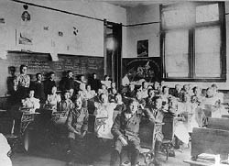

Slide 3
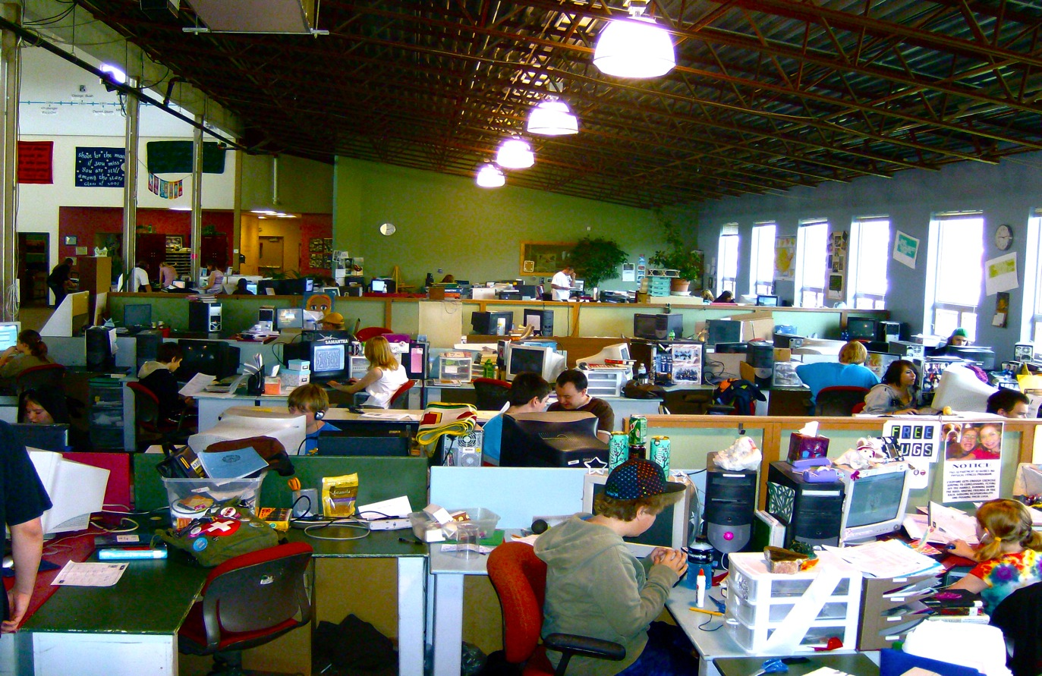

Slide 4
What is Blended Teaching & Learning?
Incorporates the best of face-to-face learning and online strategies.
Blending is not new. Teachers have always blended their methods.
Guiding Principle: Use the right tool, in the right situation, for the right purpose.

Slide 5
Definitions
“the thoughtful integration of classroom face-to- face learning experiences with online learning experiences”
“Blended learning combines online with face-to-face learning. The goal of blended learning is to provide the most efficient and effective instruction experience by combining delivery modalities”.
“Blended learning - mixed mode or hybrid - learning is the integration of face-to-face (F2F) learning with online learning activities”

Slide 6
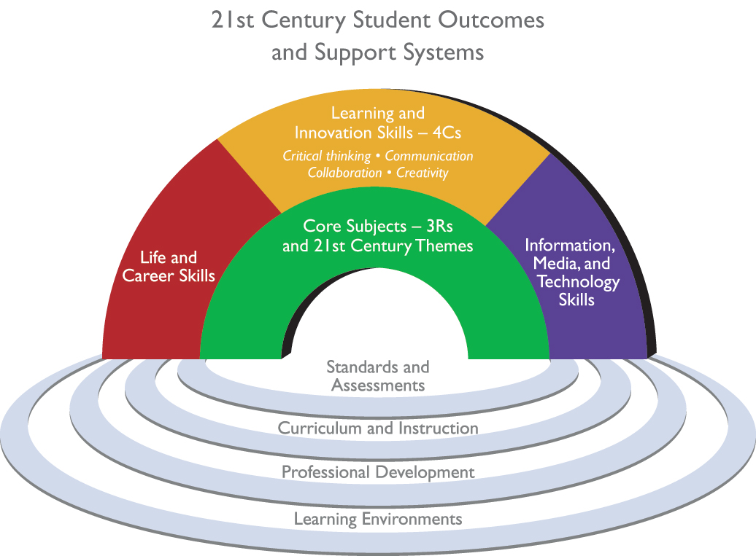
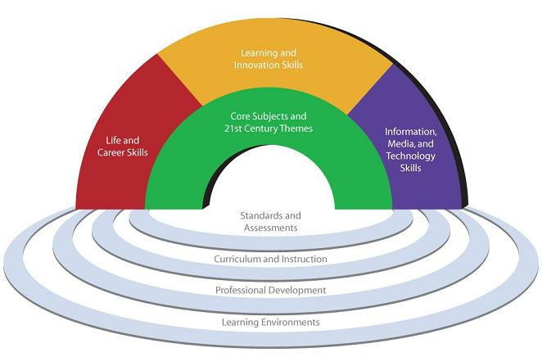
21st Century Skills
21st Century Learning

Slide 7
Effects of Technology on Classrooms & Students
Change in student & teacher roles (Students do most of the work. The teacher is a facilitator of learning.)
Increase in student motivation and self esteem
Increase in students’ technical skills
Increase in student collaboration with peers
Improved presentation skills/ attention to details
2c

Slide 9
Notes:
Policies to require online coursework (Alabama, Idaho, Florida, Michigan and Virginia) or to fund course-level choice (Florida, Utah, Louisiana and others).

Slide 10
Post-Secondary Online Enrollment
 | Students Taking at Least 1 Online Course | Increase Over Previous Year | % Increase
2002 | 1,602,970 | n/a | n/a
2003 | 1,971,397 | 368,427 | 23.0%
2004 | 2,329,783 | 358,386 | 18.2
2005 | 3,180,050 | 850,267 | 36.5
2006 | 3,488,381 | 308,331 | 9.7
2007 | 3,938,111 | 449,730 | 12.9
2008 | 4,606,353 | 668,242 | 16.9
2009 | 5,579,022 | 972,669 | 21.1
2010 | 6,142,280 | 563,258 | 10.1
2011 | 6,714,792 | 572,512 | 9.3

Slide 11
Blended Learning Models
Notes:
1. Rotation model – a program in which within a given course or subject (e.g., math), students rotate on a fixed schedule or at the teacher’s discretion between learning modalities, at least one of which is online learning. Other modalities might include activities such as small-group or full-class instruction, group projects, individual tutoring, and pencil-and-paper assignments.
a) Station Rotation – a Rotation-model implementation in which within a given course or subject (e.g., math), students rotate on a fixed schedule or at the teacher’s discretion among classroom-based learning modalities. The rotation includes at least one station for online learning. Other stations might include activities such as small-group or full-class instruction, group projects, individual tutoring, and pencil-and-paper assignments. Some implementations involve the entire class alternating among activities together, whereas others divide the class into small-group or one-by-one rotations. The Station-Rotation model differs from the Individual-Rotation model because students rotate through all of the stations, not only those on their custom schedules.
b) Lab Rotation – a Rotation-model implementation in which within a given course or subject (e.g., math), students rotate on a fixed schedule or at the teacher’s discretion among locations on the brick-and-mortar campus. At least one is a learning lab for predominantly online learning, and the other(s) are classroom(s) for other learning modalities. The Lab-Rotation model differs from the Station-Rotation model because students rotate among locations on the campus instead of staying in one classroom for the blended course or subject.
c) Flipped Classroom – a Rotation-model implementation in which within a given course or subject (e.g.. math), students rotate on a fixed schedule between face-to-face teacher-guided practice (or projects) on campus during the standard school day and online delivery of content and instruction of the same subject from a remote location (often home) after school. The primary delivery of content and instruction is online, which differentiates a Flipped Classroom from students who are merely doing homework practice online at night. The Flipped-Classroom model accords with the idea that blended learning includes some element of student control over time, place, path, and/or pace because the model allows students to choose the location where they receive content and instruction online.
d) Individual Rotation – a Rotation-model implementation in which within a given course or subject (e.g., math), students rotate on an individually customized, fixed schedule among learning modalities, at least one of which is online learning. An algorithm or teacher(s) sets individual student schedules. The Individual-Rotation model differs from the other Rotation models because students do not necessarily rotate to each available station or modality.
2. Flex model – a program in which content and instruction are delivered primarily by the Internet, students move on an individually customized, fluid schedule among learning modalities, and the teacher-of-record is on-site. The teacher-of-record or other adults provide face-to-face support on a flexible and adaptive as-needed basis through activities such as small-group instruction, group projects, and individual tutoring. Some implementations have substantial face-to-face support, and others have minimal (e.g., some flex models may have face-to-face certified teachers who supplement the online learning on a daily basis, whereas others may provide little face-to-face enrichment; others may have different staffing combinations; these are useful modifiers to describe a particular Flex model.)
3. Self-Blend model - describes a scenario in which students choose to take one or more courses entirely online to supplement their traditional courses and the teacher-of-record is the online teacher. Students may take the online courses either on the brick-and-mortar campus or off-site. This differs from full-time online learning and the Enriched-Virtual model (see the next definition) because it is not a whole-school experience. Students self-blend some individual online courses and take other courses at a brick-and-mortar campus with face-to-face teachers.
4. Enriched-Virtual model – a whole-school experience in which within each course (e.g., math), students divide their time between attending a brick-and-mortar campus and learning remotely using online delivery of content and instruction. Many Enriched-Virtual programs began as full-time online schools and then developed blended programs to provide students with brick-and-mortar school experiences. The Enriched-Virtual model differs from the Flipped Classroom because in Enriched-Virtual programs, students seldom attend the brick-and-mortar campus every weekday. It differs from the Self-Blend model because it is a full-school experience, not a course-by-course model.

Slide 12
Where is your classroom on the continuum?

Slide 13
Notes:
shifts the paradigm of classroom learning and teaching from “teacher focused’ to “student focused”
blended learning also directly prepares our 21st century learners for a world where there is no sole teacher, the onus is on the individual to make decisions after using all of the resources available to aid in the process

Slide 14
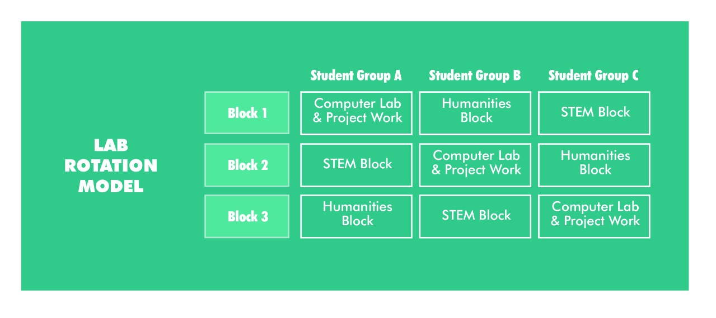
Lab Rotation Model
Notes:
Early proof-point schools, such as KIPP Empower and Rocketship Education, have run successful Rotation models for enough years now to offer helpful blueprints.

Slide 15
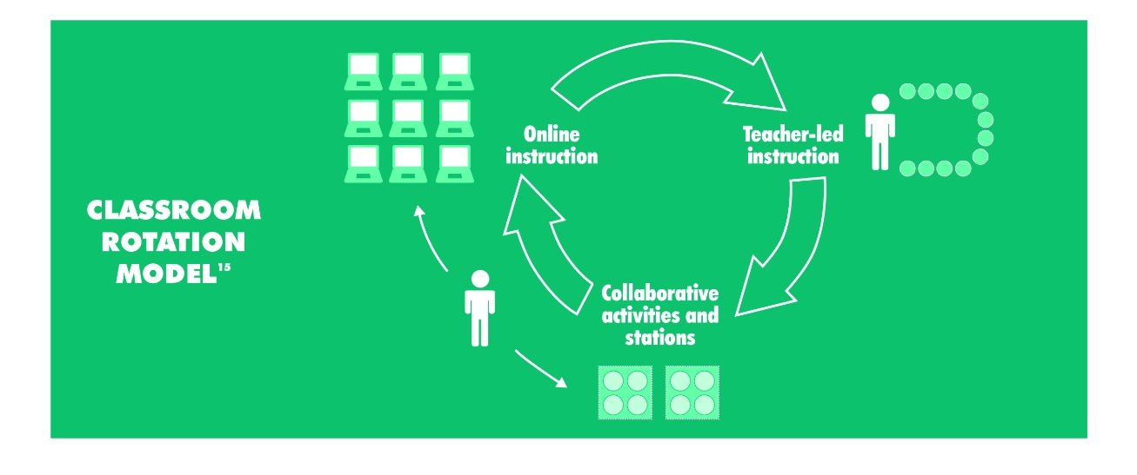
Classroom Rotation Model

Slide 16
The Flipped Classroom

Slide 17
Trends

Slide 19
MOOCs (Massive Open Online Courses)

Slide 20
MOOCs in Higher Education
http://sloanconsortium.org/

Slide 21
“Learning To Do”
http://educurious.org/
Notes:
Educurious™ is on a mission to transform the experience and outcomes of secondary school. Our project-based curriculum connects students to real issues they care about and equips them with the lifelong learning skills for success. Our courses deliver on Common Core Standards via our web platform, which fosters collaboration among students, teachers and our global network of real-world Experts. Together, we’re creating the 21st-century education that our kids and our country need to thrive in a fast-changing world.

Slide 22
Learning Platforms
Learning Management Systems
Social Learning Platforms
Blended Learning Platforms
Instructional Improvement Systems
Online Learning Providers
Adaptive Content Providers
Assessment and Data Platforms
Grade-level collections and tablet bundles

Slide 23
https://www.coursesites.com/webapps/Bb-sites-course-creation-BBLEARN/pages/index.html
Notes:
CourseSites is a free, hosted online course creation and facilitation service that empowers individual K–12 teachers, college and university instructors and community educators to add a web–based component to their courses, or even host an entire course on the Internet. You even choose your own URL, so students can find your page easily.

Slide 24
http://www.edmodo.com/
Notes:
Free. Both Edmodo and Schoology are free.
Full Collaborative LMS. Both Edmodo and Schoology are full-fledged Learning Management Systems, including assessment building tools, discussion platforms, assignment creators, scheduling tools and announcement boards.
Interface. Both Edmodo and Schoology feature a Facebook-like interface that is clean, appealing to students and fairly easy to use.

Slide 25
Notes:
1. YouTube Videos (www.youtube.com) 2. Animoto & New Hive Projects (www.animoto.com / www.newhive.com) 3. Quizlet Cards and Games (www.quizlet.com) 4. LiveScribe Pencasts 5. ThingLinks (www.thinglink.com) Click here for detailed instructions from the ThingLink Blog

Slide 26
Free Tools

Slide 27
https://www.khanacademy.org/
Notes:
Khan Academy is an organization on a mission. We're a not-for-profit with the goal of changing education for the better by providing a free world-class education for anyone anywhere.
All of the site's resources are available to anyone. It doesn't matter if you are a student, teacher, home-schooler, principal, adult returning to the classroom after 20 years, or a friendly alien just trying to get a leg up in earthly biology. Khan Academy's materials and resources are available to you completely free of charge.

Slide 28
Live Audience Polling
http://www.polleverywhere.com/

Slide 29
Free websites and blogs
Drag and drop interface
Easy to use (little technical skills required)
Dozens of design templates
http://www.weebly.com/

Slide 30
Wikis
http://www.wikispaces.com/

Slide 31
SurveyMonkey
https://www.surveymonkey.com/

Slide 32
Prezi
http://prezi.com/
http://prezi.com/-hqxdxzhxviz/teaching-for-the-future/

Slide 33
Online Engagement
Below are some examples of online engagement:
Online discussions
Case studies
Online tests/quizzes
Practice exercises
Virtual tutorials or labs
Essays (submit online)
Online literature searches
Simulations

Slide 34
Pedagogical Reasons for Online Engagement
Allow for new types of assignments.
Refocus classroom time.
Allow for collaboration.
Encourage reluctant participants.
Accommodate different learning styles and levels.
Give instant feedback to students.
Archive course information.
Deliver online or distance education courses.
Provide students with transferable skills for other courses and in their careers.
Be environmentally friendly.
Notes:
Allow for new types of assignments. Some assignments simply cannot be done on paper. For example, you can have students work with a simulation (in two or three dimensions) to see what happens when they change one element. Or they can see full colour pictures or artwork to analyze or critique. Allow yourself to think beyond the limitations of paper-based assignments to create new ways to enhance your students’ learning.
Refocus classroom time. As with traditional assignments, you can have students cover content and do activities outside of class time so you can spend your in-class time in other ways. For example, students can engage in an online discussion and then be able to bring that knowledge to class for a more in-depth discussion. Or a pre-class quiz can highlight problem areas for you to focus on in your lecture. You may also be able to reduce in­class hours if your online activities are well-planned.
Allow for collaboration. Research has shown that one way to increase student learning is to promote collaboration where groups of students can interact with each other to solve a problem or discuss an issue together. Assignments which allow for such collaboration are often more effective at positively affecting student learning than individually-done assignments.
Encourage reluctant participants. Online assignments, particularly discussions, can allow even the most reluctant participants to join in a discussion. The online (often asynchronous) nature of such assignments gives students an opportunity to reflect and generate a response to a particular question – time not necessarily allowed in a face-to-­face, synchronous discussion.
Accommodate different learning styles and levels. Beyond encouraging participation from reluctant students, online assignments can have a multi-modal design (i.e., graphics, text, audio, virtual hands-on activities) and, if designed appropriately, can also help students reach new learning levels or think more deeply or critically about a given concept.
Give instant feedback to students. One of the real benefits to students of online assignments is the possibility for instant feedback on their work. Many tools used to create such assignments can be configured to provide such feedback, instead of having students wait for assignments to be graded and returned. This way, they know immediately what concepts they need to work on, and which they already understand. This can also help instructors to identify unclear concepts or students who may need remedial assistance.
Archive course information. Online assignments also allow for an archive to be created of relevant course information and discussions. This information can be used by students at a later date while studying for a test/exam, or by the instructor to create a frequently asked questions page or to measure students’ understanding of key concepts.
Deliver online or distance education courses. If a course is being offered online or at a distance, then online assignments are a natural extension of this.
Provide students with transferable skills for other courses and in their careers. Some instructors are interested in integrating key skills into their courses that students can use in other courses or take out into the “real-world” upon completion of their degrees. If this is a goal for your courses, then providing some familiarity with certain technologies through the use of online assignments may be a good way to introduce students to skills they can use elsewhere.
Be environmentally friendly. Paperless assignments are a good way to save environmental resources.

Slide 35
Can it be blended?
F2F assignment | List what you can switch from F2F to Online delivery. | How would you ensure students achieve at least the same learning outcomes? Could you increase the rigor? | What is the rationale for switching to online delivery? (There should be a clear pedagogical reason for doing so.)
Notes:
More Cramming of Technology into the Existing Model In many quarters we're seeing schools buy technology for technology's sake, and it ends up collecting dust in the corner or contributing little to student outcomes. Our New Year's wish is for leaders to champion blended learning exclusively for the sake of students. Designing a student-centric system is the key to making next-generation learning designs enticing for the people at the heart of the issue--kids.

Slide 36
Contact Info.
Dr. Tamerin Capellino
capellin@brandman.edu
tcapellino@verizon.net
Drtamerincapellino.weebly.com (website)

Slide 37
Resources/Links
http://www.insidehighered.com/news/2013/01/08/survey-finds-online-enrollments-slow-continue-grow#ixzz2Rnwp1M3C http://sloanconsortium.org/
http://edudemic.com/2010/07/the-100-best-and-free-online-learning-tools/

