Slide 2
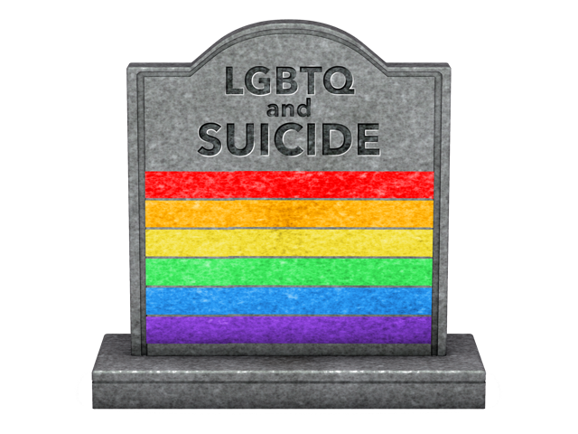
LGBTQ+ Mental Health and Suicide
“Just Because There Isn’t A Label That Fits Exactly Where You Are, Doesn’t Mean YOU Don’t Exist”

Slide 3
LGBTQ+ & Mental Health
Lesbian. Gay. Bisexual. Transgender. Queer.
Mental Health is important, without it we can’t function: Personally or academically
We all experience ups and downs. BUT we all have different reactions to these ups and downs as we individually have different situations and circumstances.
Not everyone has the same path I had. There are many students and individuals who don't have the support i had, and feel like they don’t exist and commit suicide. My friend Junior was one of those.
LGBTQIA individuals are 3 times more likely than others to experience depression or anxiety which can lead to suicide, suicidal thoughts or engage in self-harm
https://www.nami.org/Find-Support/LGBTQ --National Alliance on Mental Illness: LGBTQ
https://www.nami.org/Find-Support/LGBTQ

Slide 4
LGBTQ+ SUICIDE STATISTICS
For Americans between the ages of 15 and 24, suicide is the second leading cause of death. More than one in every 10 high school students reported having attempted suicide
1 out of 6 students nationwide (grades 9-12) seriously considered suicide in the past year
Grades 7-12 found that lesbian, gay and bisexual youth were more than twice as likely to have attempted suicide
Gay men were 6 times more likely than the heterosexual males to attempt suicide and the lesbians were 2 times more likely than heterosexual females to attempt
In the 1990’s, gay, lesbian, and bisexual youth make up 20-40% of homeless youth in urban areas. These youth were 3.5 times more likely than heterosexual youth to attempt suicide
The use of drugs and alcohol may become a tool to help with depression and low self-esteem which may then increase the chance of suicide thoughts. 68% of adolescent gay males and 83% of lesbians use alcohol, 44% of gay males and 56% of lesbians use other drugs
Most LGB youth who attempt suicide demonstrate some symptoms of psychopathology, with mood and anxiety disorders being the most prevalent diagnoses. LGB youth are also more likely to be diagnosed with an eating disorder.
In a national study, 28% of gay and lesbian high school students dropped out of school because of harassment resulting from their sexual orientation
https://www.cdc.gov/lgbthealth/youth.htm, http://www.suicidology.org/resources/facts-statistics, http://yspp.org/about_suicide/statistics.htm

Slide 5
LGBTQ Students Need Allies!
Privacy
Four of ten LGBTQ youths say the community in which they live is not accepting of LGBTQ people, which makes it absolutely imperative that educators respect students’ right to privacy.
Never reveal a student’s sexual orientation or gender identity without the student’s permission—even to the student’s family.
The climate of a school has a direct impact on both how well students learn and how well they interact with their peers.
Our goal is to generate an LGBTQ-Inclusive School Climate.

Slide 6
Gay-Straight Alliance Clubs (GSAs)
Educate students about diversity.
A recent survey of more than 10,000 LGBTQ youth by the Human Rights Campaign, and a shocking 92 percent of LGBT teens say they hear negative messages about their sexuality at school.
Top 10 High School GSAs
http://www.huffingtonpost.com/2012/06/08/gsas-10-inspiring-high-sc_n_1581159.html?slideshow=true#gallery/230162/0
GSA at Yucca Valley High School
https://yvhs-morongousd-ca.schoolloop.com/truecolors

Slide 7
Health Standards and Lesson Plans
Standard 1: Essential Concepts
1.10G Recognize that there are individual differences in growth and development, physical appearance, gender roles, and sexual orientation.
Lesson Plan: Give an essay on historical LGBT figures and their impact on us now.

Slide 8
Health Standards and Lesson Plans
Standard 2: Analyzing Influences
2.3.G Assess the discrepancies between actual and perceived social norms related to sexual activity and teenagers.
Lesson Plan: Role play a series of role plays, explores the issue of bullying on the basis of real or perceived sexual orientation or gender identity, including its manifestations, impact and actions that can be taken to prevent and respond to bullying.
http://unesdoc.unesco.org/images/0022/002277/227707e.pdf

Slide 9
Support & Resources
The Association for Lesbian, Gay, Bisexual & Transgender Issues in Counseling offers a list of resources for LGBT individuals and works to educate counseling professionals on LGBT issues.
The Association of Gay and Lesbian Psychiatrists offers numerous resources for LGBT people who are experiencing mental health conditions, including a directory of LGBT-friendly therapists.
The Center for American Progress offers a variety of resources, including a report called Why the Gay and Transgender Population Experiences Higher Rates of Substance Use.
The GLBT National Help Center provides multiple resources and access to a hotline and a youth chat line.
GLSEN (the Gay, Lesbian and Straight Education Network) provides an annual report called the National School Climate Survey, which reports on the experiences of Lesbian, Gay, Bisexual and Transgender Youth in U.S. schools.
The Pride Institute is an unlocked, LGBT-exclusive facility that offers a residential treatment program, including psychiatric care for depression, anxiety and other needs.
The Rainbow Access Initiative works to inform and educate health care providers on LGBTQ specific issues.
The Trevor Project is a multimedia support network for LGBTQ youth providing crisis intervention and suicide prevention.
https://www.nami.org/Find-Support/LGBTQ --National Alliance on Mental Illness: LGBTQ

