Slide 1
Methamphetamines Disguised as Candy
By: Richard Toliver, Juan Hernandez and
Monika Geiger

Slide 2
Jordan at 23
Jordan at 25

Slide 3
Stats and Facts
Current numbers are as follows:
8th graders at 1.6 percent
10th graders at 1.3 percent
12th graders at 1.2 percent
Almost a quarter (24%) say meth "makes you feel euphoric or very happy.“
Nearly as many (23%) said meth helps people lose weight, and
22% said meth "helps you deal with boredom."

Slide 4
Think About This……..Look

Slide 5
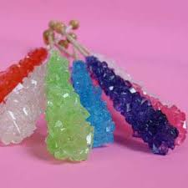
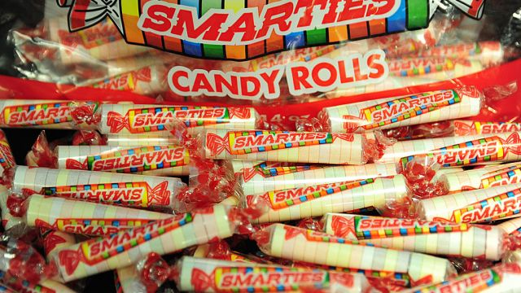
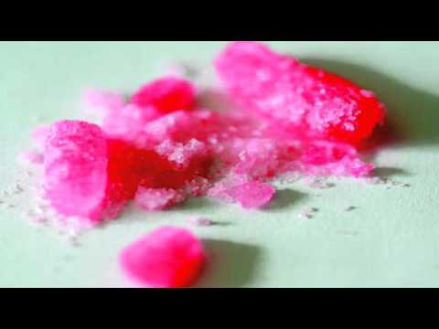
Meth made to look like candy to reinvigorate drop in use:
Meth Made To Look Like Candy Found At Ione Middle School
https://www.youtube.com/watch?v=ITgpSFaGT5A

Slide 6
Standards
1.10.A Clarify myths regarding the scope of alcohol, tobacco, and other drug use among adolescents.
Grades 9-12
Science Lesson: Students would collect info in survey concerning current thoughts, ideas, or comments about drug use.
Survey from teachers, administrators, school staff, parents, etc.
Build poster with one side myths and other side facts about drugs. Images and info part of poster to present to class.

Slide 7
Standards
6.1.A Predict how a drug-free lifestyle will support the achievement of short- and long-term goals.
Grade: 9-12
Language Arts Lesson: Group discussion of student’s life goals and how doing drug can impact their own personal lives.
Students will create an essay on the above points discussed in class.

Slide 8
Resources for Drug Use and Abuse
SAMHSA’s National Helpline is a free, confidential, 24/7, 365-day-a-year treatment referral and information service (in English and Spanish) for individuals and families facing mental and/or substance use disorders.
https://www.samhsa.gov/find-help/national-helpline
Teen Rehab Center
https://www.teenrehabcenter.org/resources/high-school-drug-use/
San Bernardino County Department of Public Health
http://www.sbcounty.gov/dph/publichealth/programs_services/adapp/adapp_home.asp

Slide 9
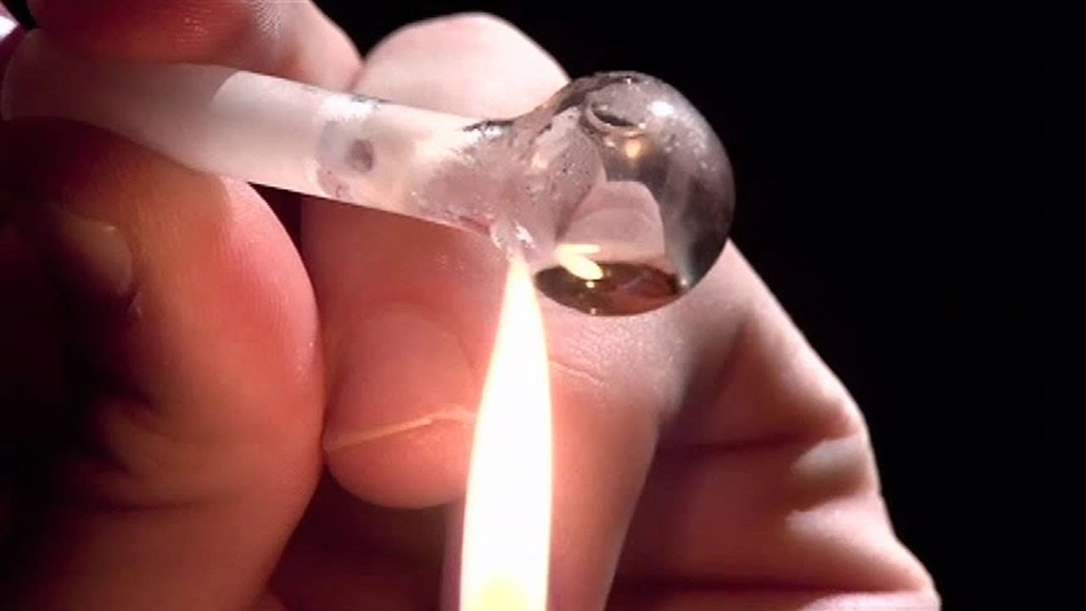
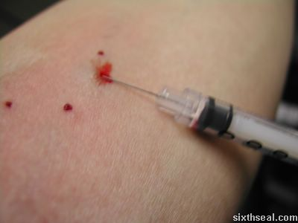
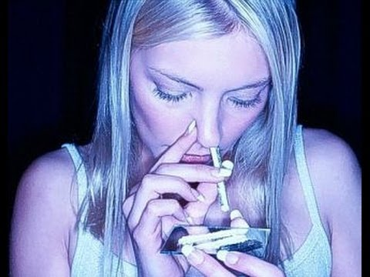
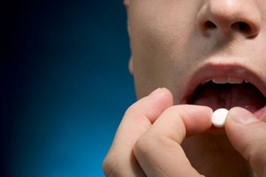
Poll Question 1 Have you tried any form of methamphetamine?

Slide 10
Poll Question 2 Which is a bigger deterrent? A. Its effects on brain and health B. Its effects on your physical appearance

Slide 11
References
Hitti, Miranda. 1 in 33 Teens Admit Trying Meth. 19 Sept. 2007, www.cbsnews.com/news/1-in-33-teens-admit-tring-meth/. Accessed 28 Jan. 2017.
Methamphetamine. What is Methamphetamine (Meth)? https://teens.drugabuse.gov/drug-facts/methamphetamine-meth. Accessed 28 Jan. 2017.
Witmer, Denise. What Every Parent Should Know About Teen Meth Use. 4 Mar. 2016, www.verywell.com/meth-use-effects-and-your-teen-2610220. Accessed 28 Jan. 2017.

