Slide 1
Health Resources
How we can educate ourselves, teach our children, better our community… Strengthen Our Future.

Slide 2
Health Resources
The following content areas are included in this PowerPoint:
Family Living and Social Health
Growth and Development
Nutrition
Personal Health and Physical Activity
Alcohol, Tobacco, and Other Drugs
Communicable and Chronic Diseases
Consumer and Community Health
Environmental Health
Injury Prevention and Safety

Slide 3
Family Living and Social Health
Family Education Family Impact
Sky Mtn. approved vendor
Phone (800) 349-2543
http://www.familyimpact.com
Parenting skills materials to strengthen marriages and families. Offers parenting resource manuals.
Family Impact enhances life by teaching correct principles and providing tools necessary to optimize human potential which empowers individuals and families to live a happy, healthy, balanced life.
Promoting social health can be done in many ways… as we home school our children, it is important that they build their confidence in the world outside of the comfort of their own homes. Here are just a few ideas:
Valverde School of Performing Arts
11981 Jack Benny Dr. #102 Rancho Cucamonga, CA 91739 (909) 987-2789
Sky Mountain Group Educational Activities
Samuel B. Mateo-
Mateo Academy of Self Defense Service
http://www.mateoacademy.com
14725 Seventh St. Ste. 100
Victorville, CA. 92395 (760) 952-3835
Local Co-Ops where they will meet other home schooled students (and where you can form a support group as well).
Community College Courses for students 16 years and older

Slide 4
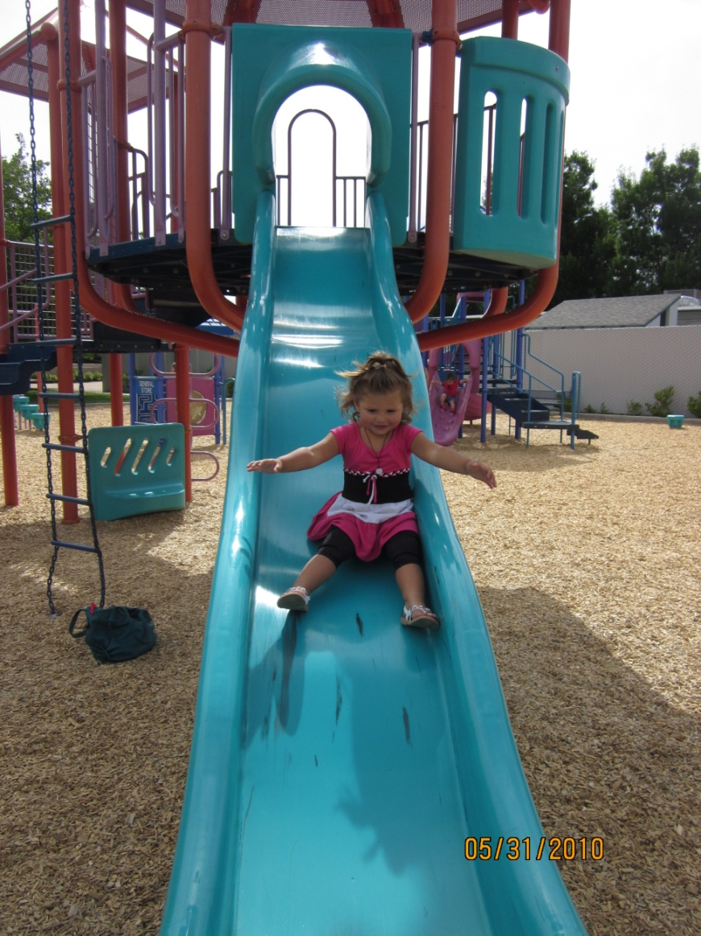
Growth and Development
Resources:
Your child’s pediatrician
Kid’s Health- http://kidshealth.org/
First 5 California
http://www.ccfc.ca.gov/
We are all concerned about the rate of our child’s growth, whether it be physical or mental. First 5 California works with most hospitals and gives free information, help and resource lists…
“Research shows that a child's brain develops most dramatically during the early years of life. We’ve worked hard to educate parents and caregivers about the important role they play in their children’s first years. First 5 California’s programs are designed to meet its goal of ensuring more children are born healthy, raised in nurturing homes and ready to succeed in school.”
http://www.ccfc.ca.gov/

Slide 5
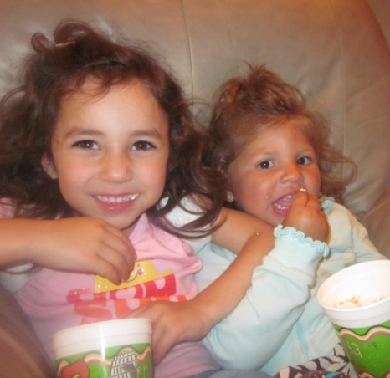
Nutrition
Spotlight on
The Dairy Council of California
This website and program is awesome! They are not just about the milk and dairy products, but they educate California, and promote overall health through proper nutrition.
The Dairy Council of CA offers:
Free milk to our students at the LA county fair (when on a field trip)
Online kid’s games & great handouts
The new and improved pyramid of the 5 food groups! http://www.dairycouncilofca.org/PDFs/my_pyramid.pdf
First 5 California
http://www.ccfc.ca.gov/
California Healthy Kids
http://www.californiahealthykids.org
Healthy People
http://www.healthypeople.gov/
Dairy Council of California
http://dairycouncilofca.org/

Slide 6
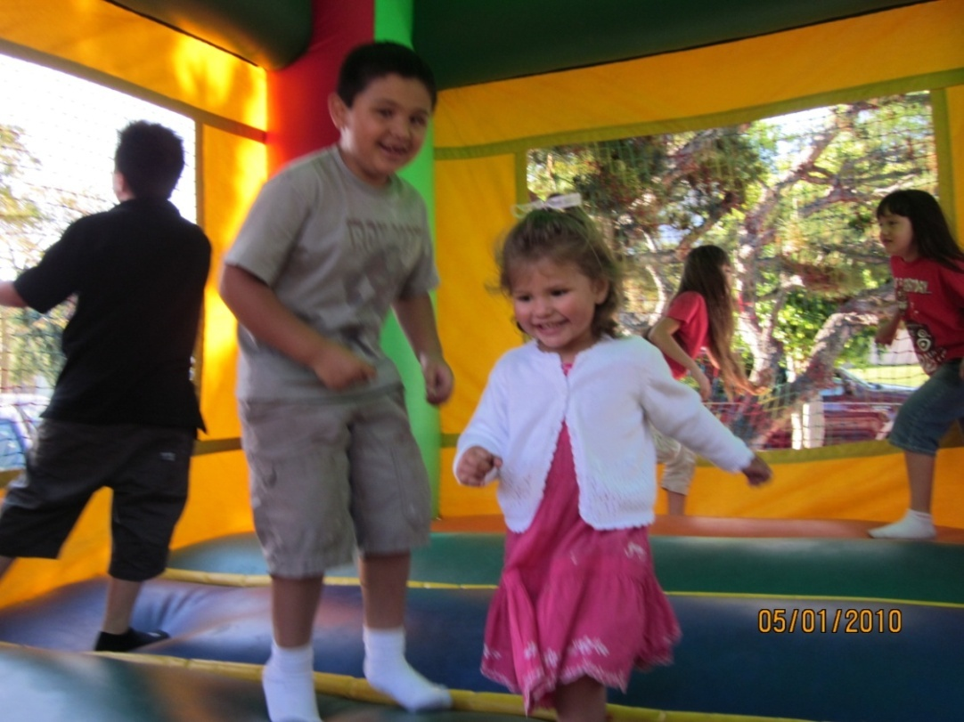
Personal Health (Inc. Mental and Emotional Health) and Physical Activity
Physical Education Model Content Standards for California Public Schools Kindergarten Through Grade Twelve
http://www.cde.ca.gov/be/st/ss/documents/pestandards.pdf
As our school is state funded, we abide by their rules and regulations… and the most demanding and time consuming jobs that we have is making sure that the students are learning… and they are learning what they are supposed to be learning (as dictated in the California State Standards).
Although this may throw a wrench in your normal style of teaching, and there may be a learning experience around every turn, know that the state has done their homework, and once you are familiar with the standards and why they want you to teach your student how to underhand throw in the 1st grade, you will be grateful for this wonderful state in which we live.
Healthy Youth- Coordinated School Health Program
http://www.cdc.gov/HealthyYouth/CSHP/
State Mental Health Resources for California
http://mentalhealth.samhsa.gov/databases/kdata.aspx?state=CA
Children’s Advocate
http://www.4children.org/
PE Central- Health/PE lesson plans, programs, ideas
http://www.pecentral.org/lessonideas/pelessonplans.html

Slide 7
Alcohol, Tobacco, and Other Drugs
It is up to you to teach your child about the dangers of drug abuse. You must do your research and know what is going on in the world around your children.
Teen Substance Abuse: http://www.webmd.com/mental-health/Alcohol-Abuse/Teen-Alcohol-and-Drug-Abuse-Topic-Overview
Preventing Drug Abuse among Children and Adolescents
This website has fantastic information, graphs and links that can help guide you as both a parent and a teacher. There is also a tab especially for students and young adults.
http://www.drugabuse.gov/prevention/risk.html
It is up to you to teach your child about the dangers of drug abuse. You must do your research and know what is going on in the world around your children.
McGraw Hill School Division Product (800)-442-9685 Publisher of elementary school materials: including science, health, etc.
http://www.mmhschool.com/
This has often been an area where many parents look to their church for information on. There may be groups that your child can be involved in, or community service in which they can participate in. You know them best, but don’t hesitate to ask for help along the way.

Slide 8
Communicable and Chronic Diseases
As your children learn about communicable and chronic diseases, here are some alternative learning ideas:
Newspaper Article
Family Narrative/ Personal Experience
Oral Presentation
Interpreting Graphs
Chronic diseases - such as heart disease, cancer, and diabetes - are the leading causes of death and disability in the United States. These diseases account for 7/10 deaths and affect the quality of life of 90 million Americans. http://www.health.state.ny.us/diseases/chronic/
California’s Division of Communicable Disease Control (DCDC) is a great resource for getting more information about communicable diseases. They work “in partnership with local, state and national health officials; university schools of public health; non-governmental organizations; clinicians; and international health agencies to promptly identify, prevent, control, and monitor infectious diseases that pose a threat to public health, including emerging and re-emerging infectious diseases, vaccine-preventable agents, bacterial toxins, possible bioterrorism, or pandemics (e.g. avian influenza in humans).” They protect us.
http://www.cdph.ca.gov/programs/dcdc/Pages/default.aspx
http://www.cdph.ca.gov/data/statistics/Pages/STDData.aspx

Slide 9
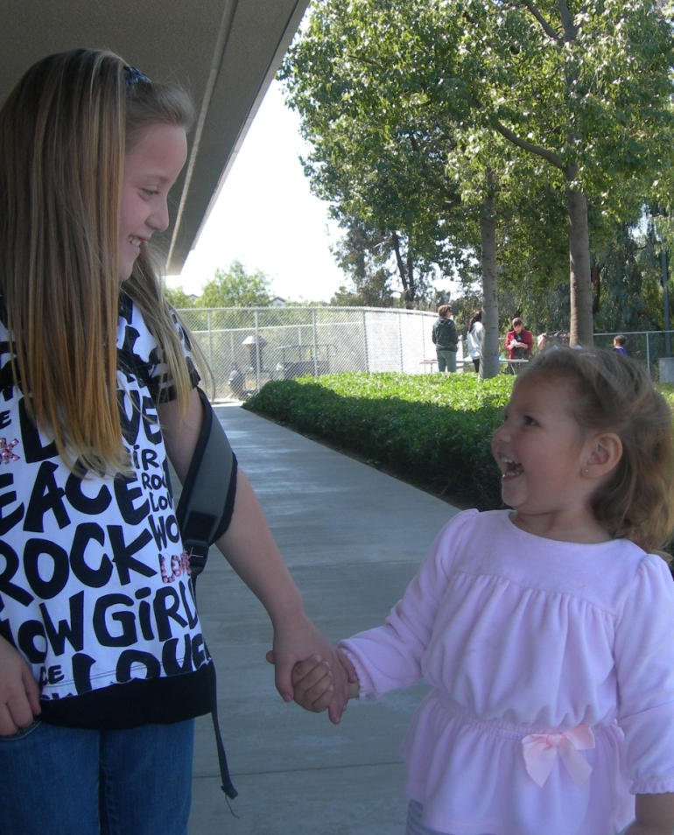
Consumer and Community Health
What is Consumer and Community Health?
We must all make health decisions, and find additional
health information when needed. Consumer health, as
discussed at the website below, is an essential
tool that youth will need to be knowledgeable
and comfortable in the fast paced
world in which we live.
Consumer and Community Health information can help youth make responsible choices on their own.
What do I want to be when I grow up?
Where can I find information about the illness the doctor said my grandma has?
http://en.wikibooks.org/wiki/Teaching_Elementary_School_Health_Education/Consumer_and_Community_Health
The University of California Berkeley offers an extensive resource website with organizations and agencies, publications and databases, and guides… all to make you and your children more knowledgeable about healthcare.
How do I balance a checkbook?
Should we go to the movies, or just hang out in the alley with the other kids?
http://www.lib.berkeley.edu/PUBL/consumer.html

Slide 10
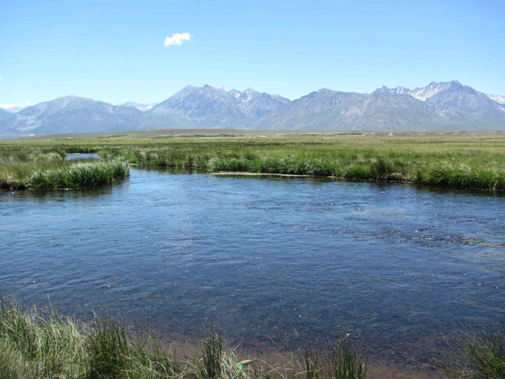
Environmental Health
A to Z Teacher Stuff
http://www.atozteacherstuff.com/Themes/Environment/
This website is worth a click of your finger… and you will surely save it to your favorites! A compilation of lesson plans for all grade levels, and all types of learners. Environmental issues can be discussed in many forms, and whether your child is interested in dinosaurs or oil spill statistics, you will appreciate all of the time that each of these teachers has put into their lessons!
Acorn Naturalists
Approved Sky Mtn. Vendor (800)422-8886
http://www.acornnaturalists.com/
Source for science and nature related educational resources and materials, thousands of hard-to-find specialty products. An established, independent bookseller and scientific and environmental supply company.
Green California
From carpooling to solar power options, California is on board with options, resources and information to keep our state beautiful for generations to come.
http://www.ca.gov/About/EnvironResources/GreenCA.html
Greening Schools
Environmental Health Curriculum, Lesson Plans, and Activities (K-12)
http://www.greeningschools.org/resources/view_resource.cfm?id=873
Environment Lesson Plans
http://www.teach-nology.com/teachers/lesson_plans/science/environment/

Slide 11
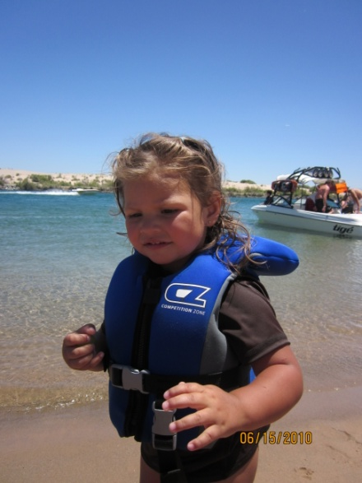
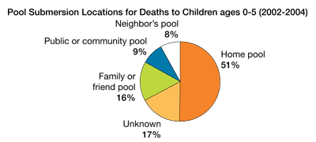
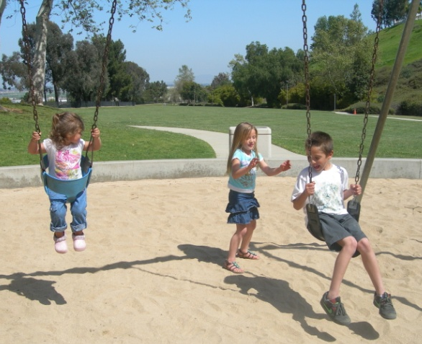
Injury Prevention and Safety
“Accidental injuries are a leading cause of hospitalization and death for young children. Because many childhood injuries happen in or around the home, it is the parents who must assume responsibility for making the home a safe place.”
http://www.parenting-ed.org/handout3/Injury%20Prevention/injury%20prevention.htm
This website is a great resource from parents, teachers, students, health professionals, and even the media! With all of the facts, information and the many resources, you will be able to make safer choices for your family.
http://www.safekids.org/
More awesome data can be found at:
http://www.safekids.org/
Rainbow Resource www.rainbowresource.com
SMCS Approved Vendor- Keyword: Safety. They have curriculum, posters, etc.
Injury Prevention For Parents
https://www.chp.edu/CHP/Injury+Prevention+For+Parents

Slide 12
Disclaimer
This information is to help guide and inform you of the options and information that is available to you through the state, community, and both non-approved and approved vendors of Sky Mountain.
This is not organized by Sky Mountain Charter School, nor are they held liable for any information within this document.
If you have any questions, feel free to contact me at kherrera@ieminc.org
Happy Learning~
Kelly Herrera
Education Specialist with Sky Mountain Charter School

