Slide 1
21st Century Teacher Leadership
Dr. Tamerin Capellino
Brandman University
California League of Schools Conference (South)
December 2nd, 1010

Slide 2
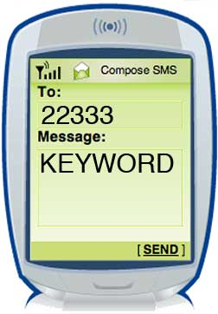
Don’t forget: You can copy-paste this slide into other presentations, and move or resize the poll.
Notes:
Press F5 or enter presentation mode to view the poll
In an emergency during your presentation, if the poll isn't showing, navigate to this link in your web browser:
http://www.polleverywhere.com/multiple_choice_polls/LTYzMDE3OTMzOQ
If you like, you can use this slide as a template for your own voting slides. You might use a slide like this if you feel your audience would benefit from the picture showing a text message on a phone.

Slide 3
Who is running our schools?
Teachers are increasingly being tapped to take on leadership roles in their schools to fill gaps left by vice principals and other administrators who have been eliminated due to budget cuts.
California had 0.4 district officials and administrators per 1,000 students in 05-06.
That was considerably lower than the U.S. average of 1.3 per 1,000 students
California had only 33% as many district officials/administrators as the national average and only 63% as many school principals and assistant principals.
National Center for Educational Statistics (NCES), Common Core Data 2005-2006

Slide 4
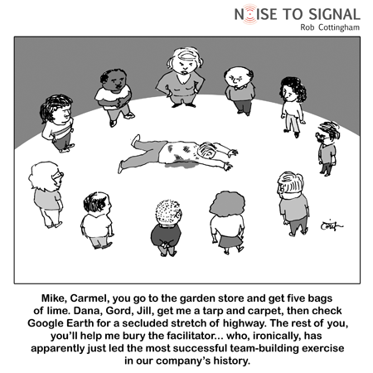
Team Building

Slide 5
Team Building
Research tells us that a key component of students being successful in school is having connections to people on campus. The same can be said for teachers.

Slide 6

A Penny For Your Thoughts
Each group member is given a coin (penny, nickel, dime, quarter) with different dates of issue. After each member has received a coin and looked at the date, the group leader or facilitator gives the members a prompt such as:
What was your greatest challenge you experienced in that year?
What was your greatest success that year?
What would you do differently that year if you could?
Each member of the group shares their responses. This activity can be used during team building as well as during subsequent meetings by changing the prompt.

Slide 7

Artifacts
The group leader or facilitator requests that each member of the team bring in an artifact from their life they would be willing to share. Examples of artifacts include:
Wedding toast from their wedding
A family bible
A piece of jewelry
Photographs
Piece of clothing
Written piece of work
Souvenir from a trip
Heirloom
Each member of the group shares their “artifact” and its significance to their life.

Slide 8

Technology and Internet Resources
Education leaders must be technologically savvy in this day and time. Leaders also need to be familiar with the myriad of online resources available, many at no cost, that will help them develop websites or create interactive classrooms without the expense of installing a costly Smart Classroom system.

Slide 9
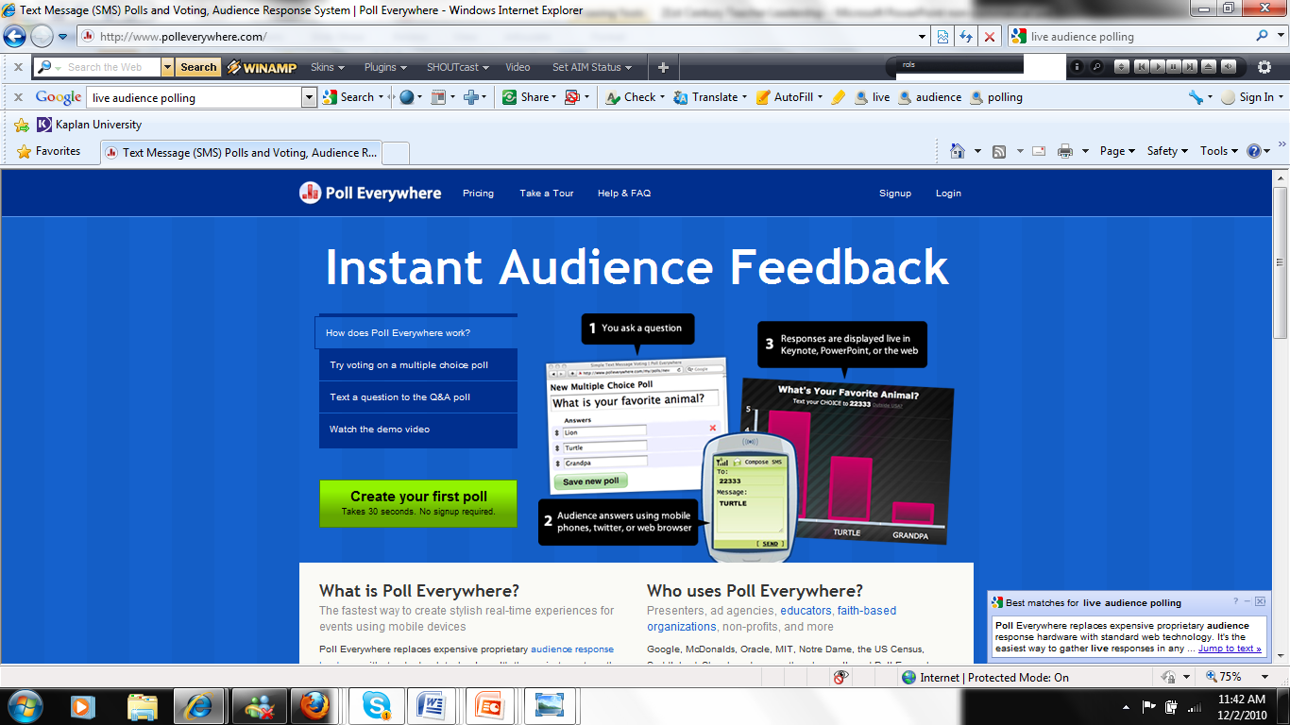
Live Audience Polling
http://www.polleverywhere.com/

Slide 10

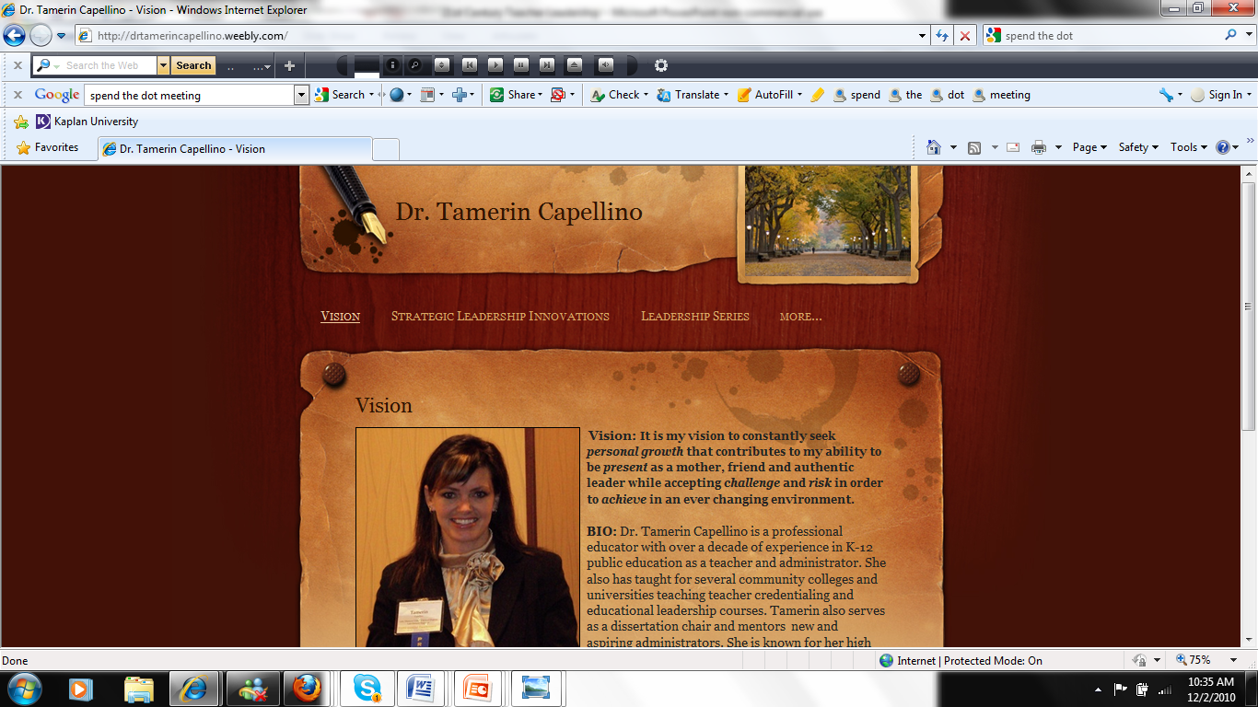
http://www.weebly.com/
Free websites and blogs
Drag and drop interface
Easy to use (little technical skills required)
Dozens of design templates

Slide 11
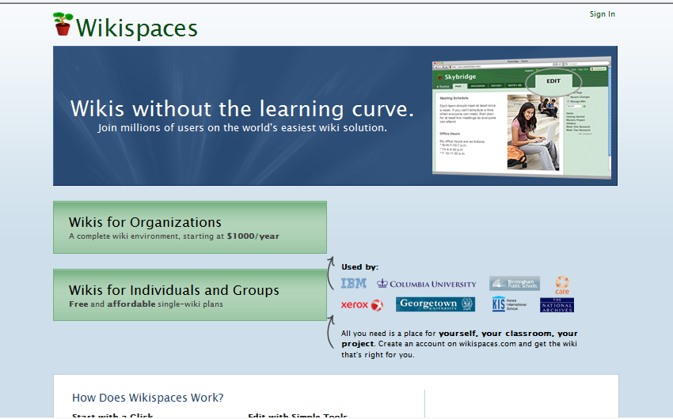
Wiki’s for Collaboration
http://www.wikispaces.com/

Slide 12
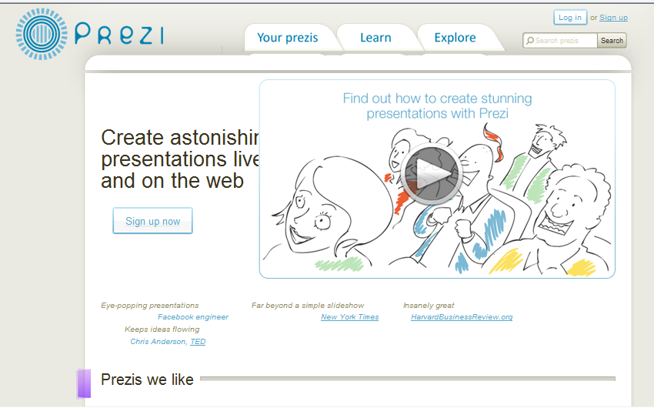
Prezi
http://prezi.com/
http://prezi.com/-hqxdxzhxviz/teaching-for-the-future/

Slide 13
Surveys (Environmental Scans)
Historically, teachers have worked in isolation. Instructional leaders need to survey their whole environment and reach out to all stakeholders just as effective classroom teachers survey students and parents to find out what they need and desire.
http://www.surveymonkey.com/
  FREE! (up to 10 questions)
  Easy to use
  Instant reports/feedback

Slide 14
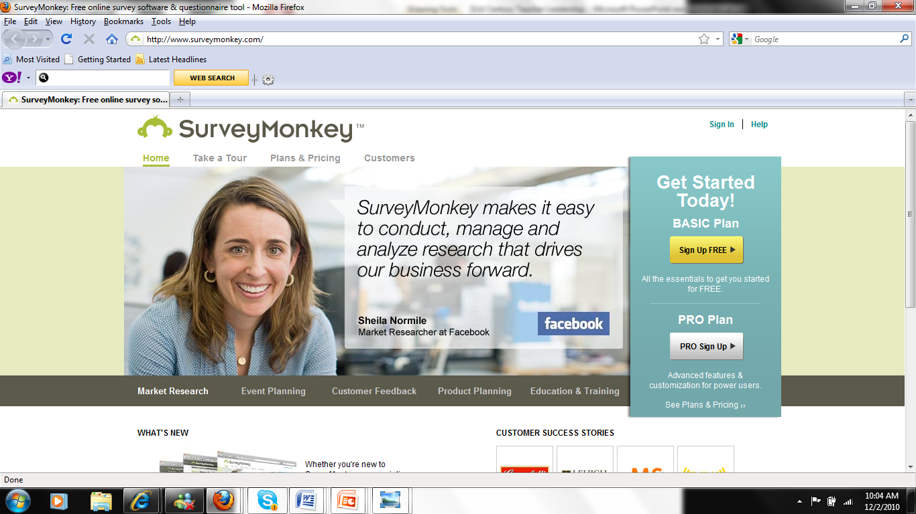
SurveyMonkey

Slide 15
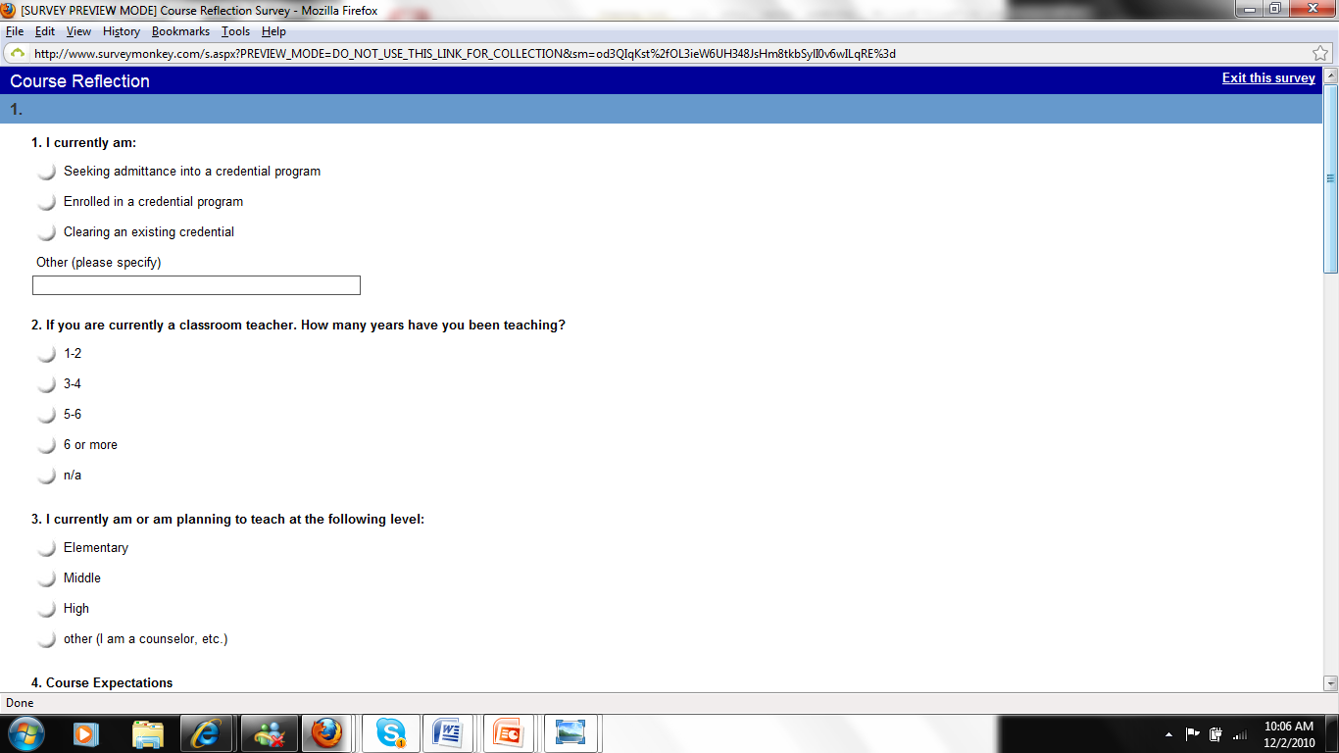
Sample Survey

Slide 16
Don’t forget: You can copy-paste this slide into other presentations, and move or resize the poll.
Notes:
Press F5 or enter presentation mode to view the poll
In an emergency during your presentation, if the poll isn't showing, navigate to this link in your web browser:
http://www.polleverywhere.com/free_text_polls/MTU4NjIxODI0OA
If you like, you can use this slide as a template for your own voting slides. You might use a slide like this if you feel your audience would benefit from the picture showing a text message on a phone.

Slide 17
Meeting Strategies/Structuring Devices
Effective leaders/teachers need to be able to engage and encourage their peers to participate in meetings and their students to participate in lessons by creating small group sessions, which are less intimidating and more informal.
http://www.youtube.com/watch?v=32WjO7IiHpI

Slide 18
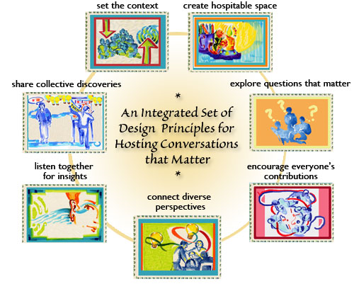
The World Cafe
theworldcafe.com

Slide 19

Open Space technology (OST)

Slide 20
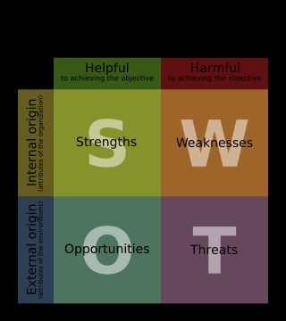
S.W.O.T. Analysis

Slide 21
Don’t forget: You can copy-paste this slide into other presentations, and move or resize the poll.
Notes:
Press F5 or enter presentation mode to view the poll
In an emergency during your presentation, if the poll isn't showing, navigate to this link in your web browser:
http://www.polleverywhere.com/multiple_choice_polls/MjAzNjc4MjQy
If you like, you can use this slide as a template for your own voting slides. You might use a slide like this if you feel your audience would benefit from the picture showing a text message on a phone.

Slide 22
Contact me
capellin@brandman.edu
drtamerincapellino.weebly.com

